Slide 1

SAP
APPROVAL WORKFLOW
User Manual - SAP approval workflow
Date: 15/07/2025
RANE MADRAS LIMITED , VELACHARY
User Manual
1 of 20

Slide 2
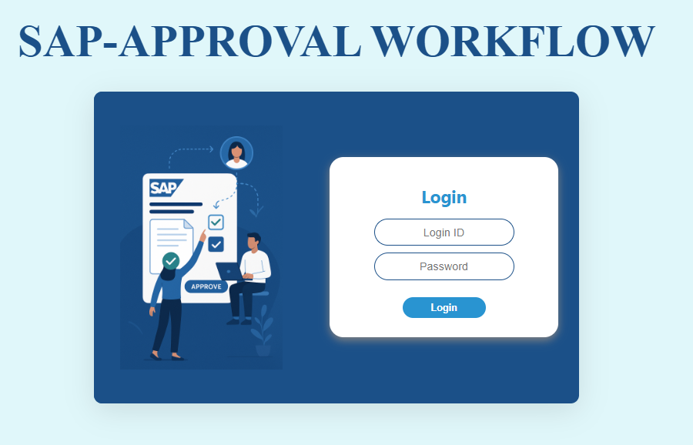
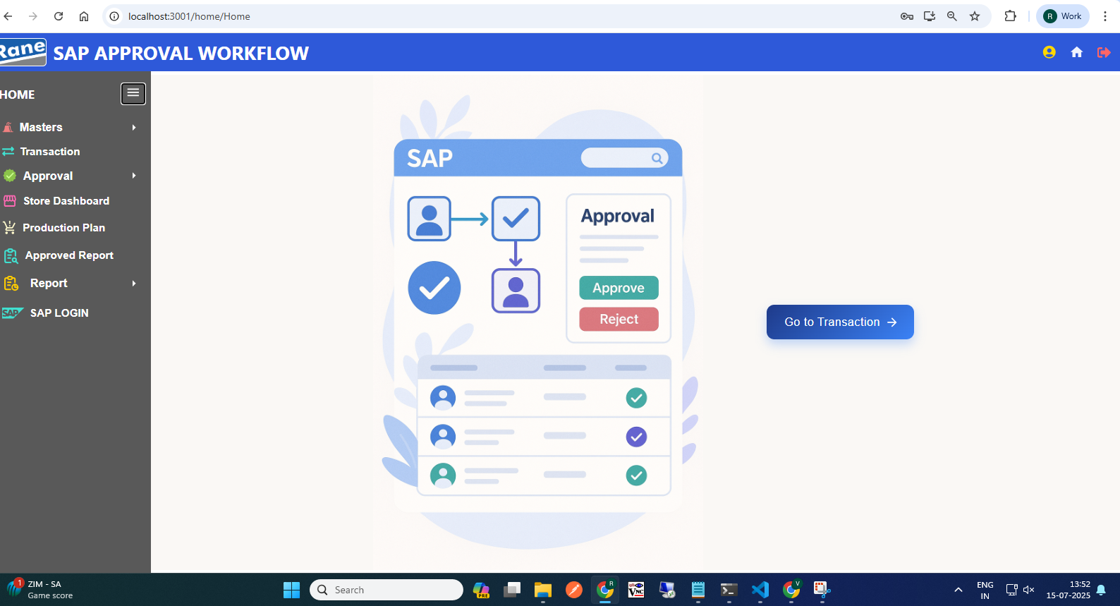
Login Page
Home Page
2
Click Here, go to the Transaction Dashboard

Slide 3
309 Movement Transaction
Process workflow:
1.Create Request by Users ( PROD / MMD / QAD / MED )
2.Upload Process - Fill in required details
3. Upload Output:
i) New Records, ii) Error Records, iii)Duplicate Records
4. Submit for Approval to Level 1 User.
Level 1 : PLANT FINANCE HEAD
Level 2 : PLANT MRPC
Level 3 : PLANT HEAD
Level 4 : CORP FINANCE HEAD
Level 5 : CORP MRPC
5. Requester Page Visible Data: - Only data uploaded by the logged-in user,
Statuses: Pending, Under Query
6. Download Option: - Filtered by From–To Date & Movement Type
7. Editability: - Enabled only if status is Under Query
8. Resubmit Workflow: - Enabled only if status is Under Query Select rows using checkboxes After making corrections, click Resubmit
5

Slide 4
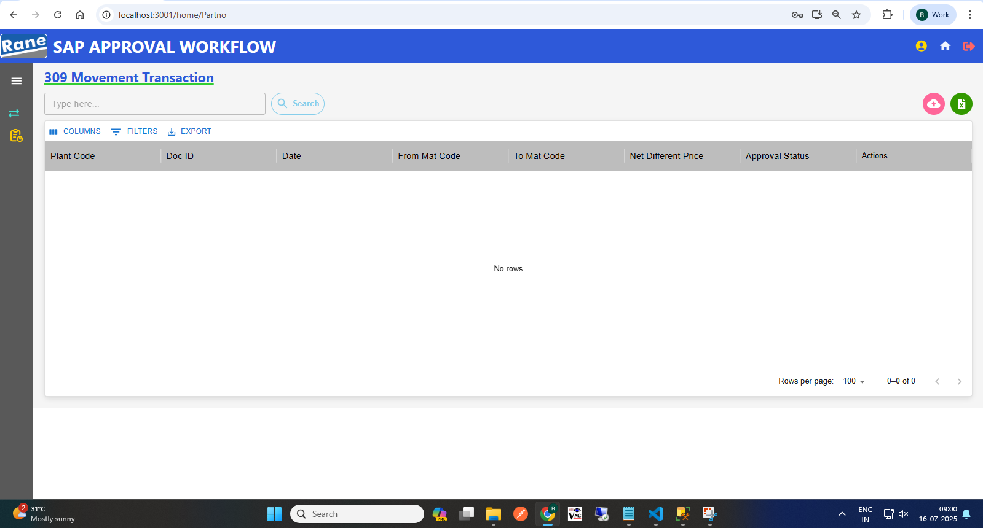
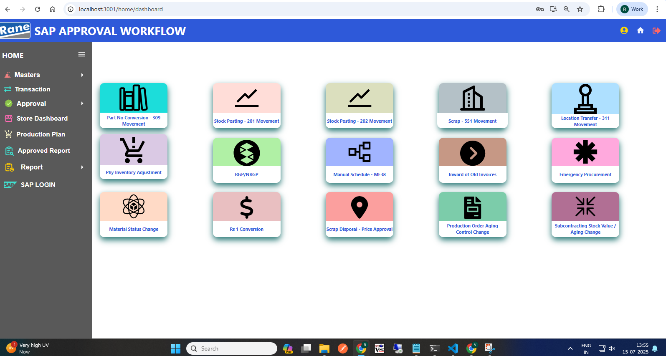
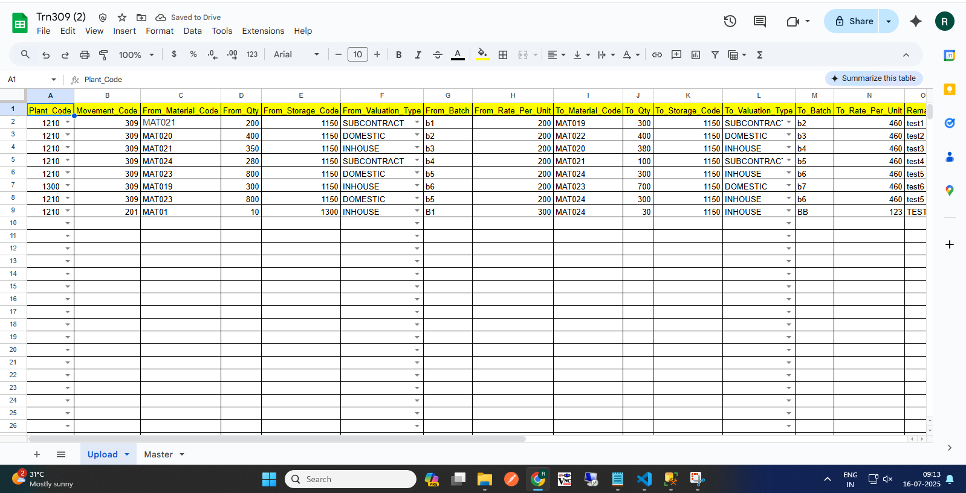
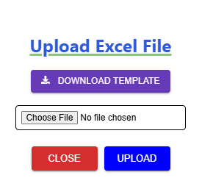
309 Movement Request (Requester)
4
(1) Click to begin a 309 request
(2) Click here to Download template
(4) Excel Template with Sample Data
(3) Upload
(5) Approval workflow
Request >>> L1 Approver: Plant Finance Head >>> L2 Approver: Plant MRPC >>> L3 Approver: Plant Head >>> L4 Approver: CORP Finance Head >>> L5 Approver: Corp MRPC >>> Send to SAP.

Slide 5
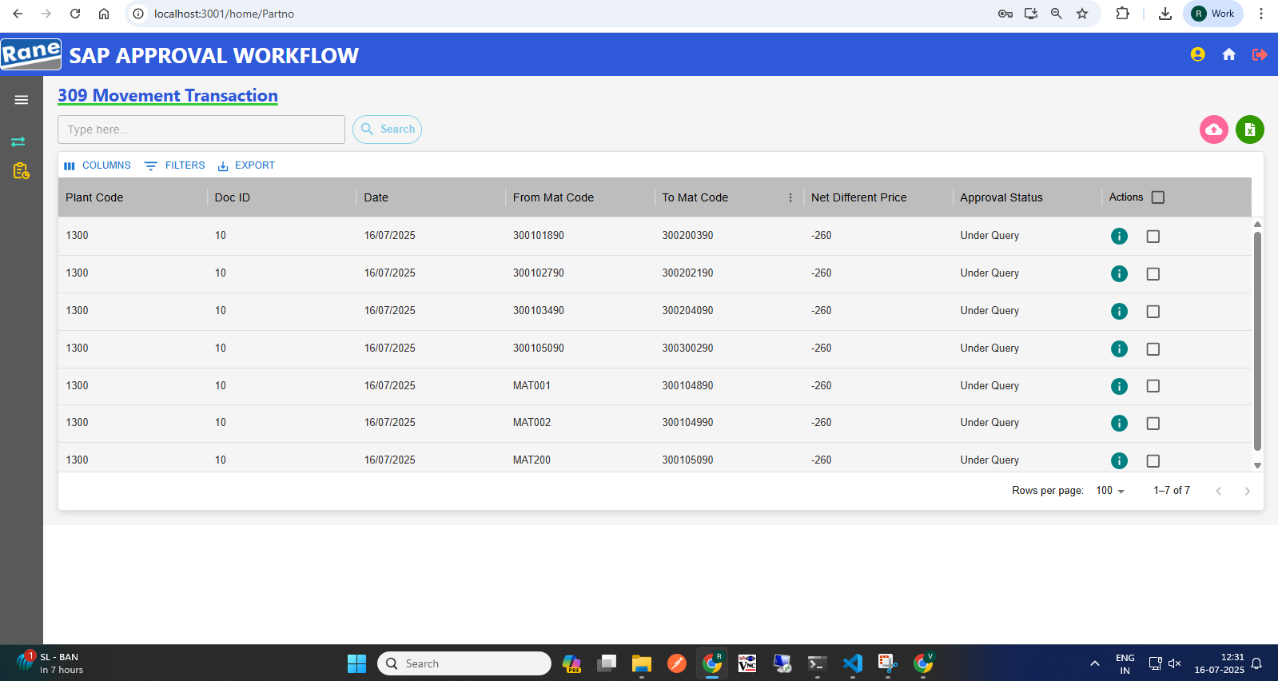
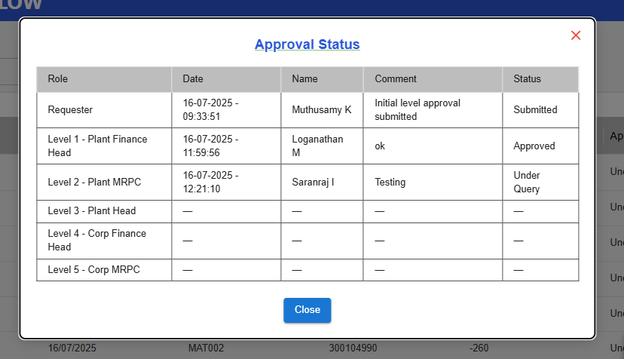
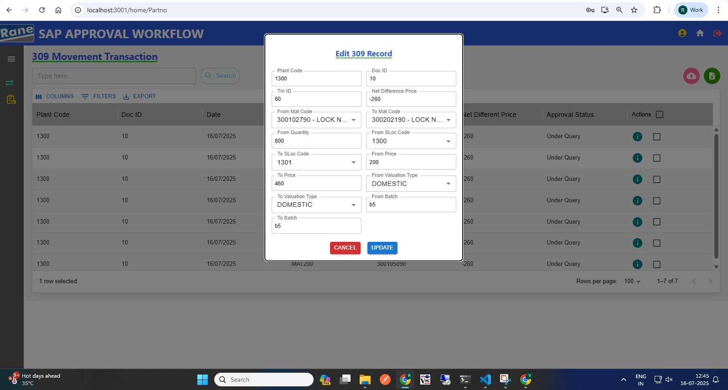
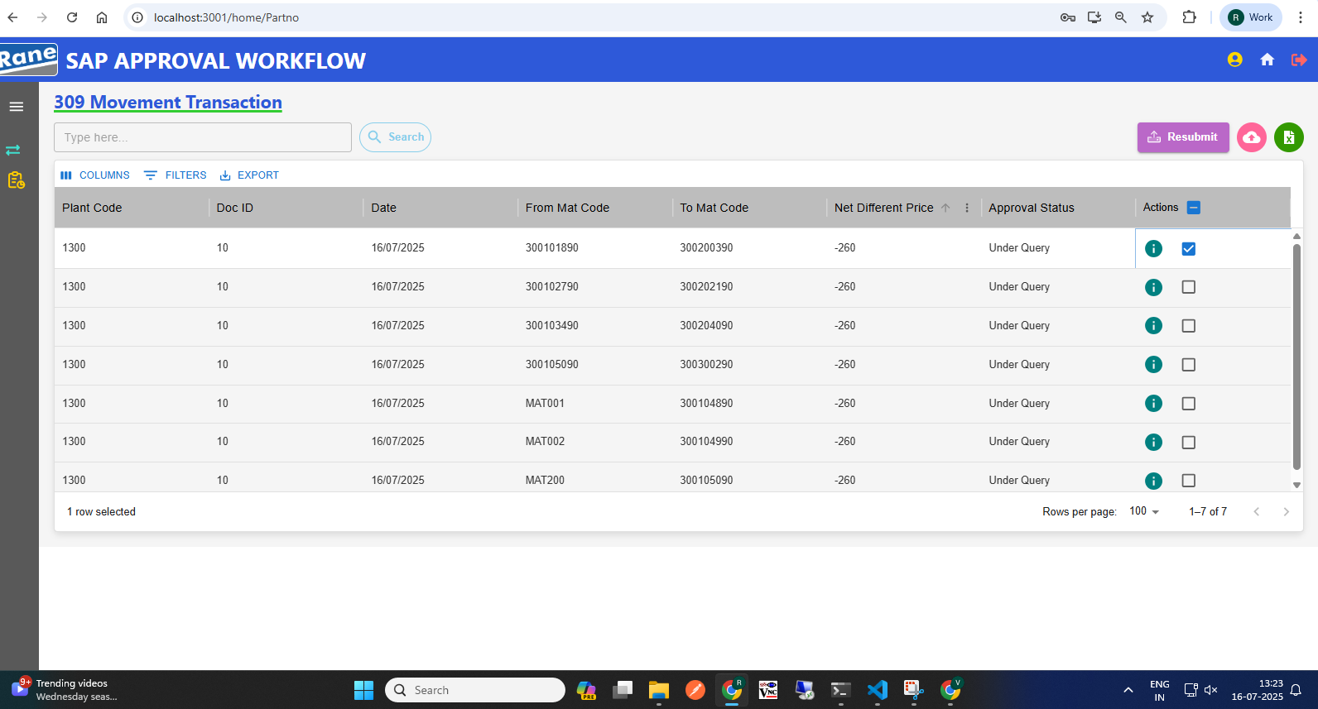
309 Movement: Edit with Status "Under Query" (Requester)
4
(2) View the Approval Level & Status
(3) Click Row to Edit Row, Then Update
(1) Requester Page After "Under Query" Status
(1) Click here to View status
(4) Select Checkbox, Then Submit Data
Resubmit workflow
Status: Under Query>>> Edit>>> Re-submit>>>Send to Approver.

Slide 6
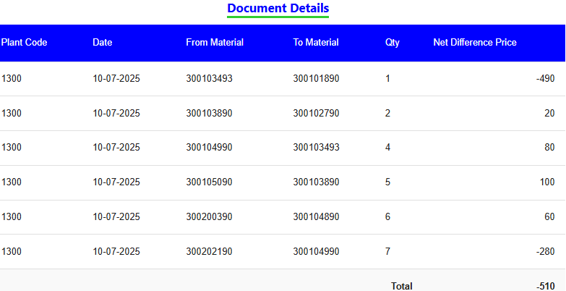
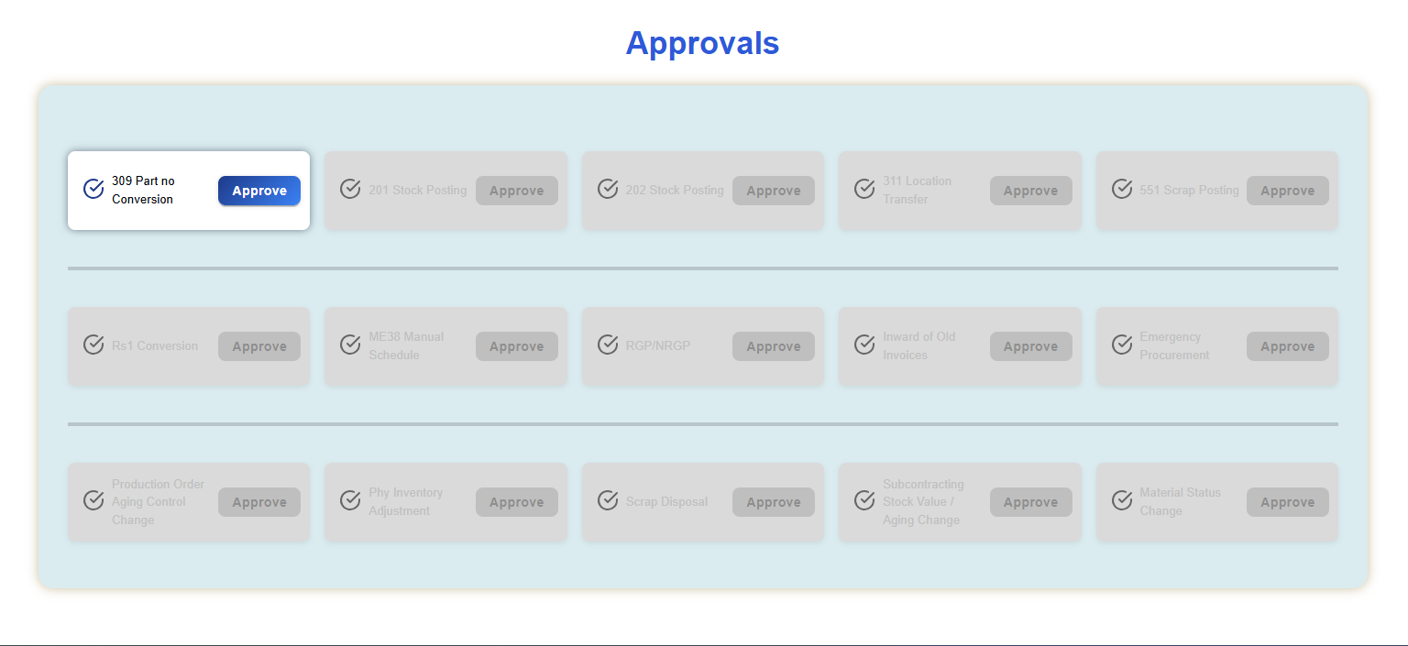
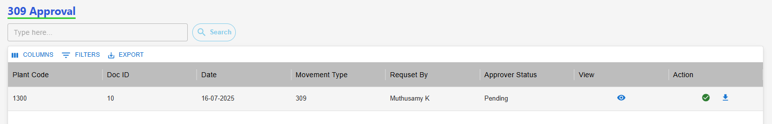
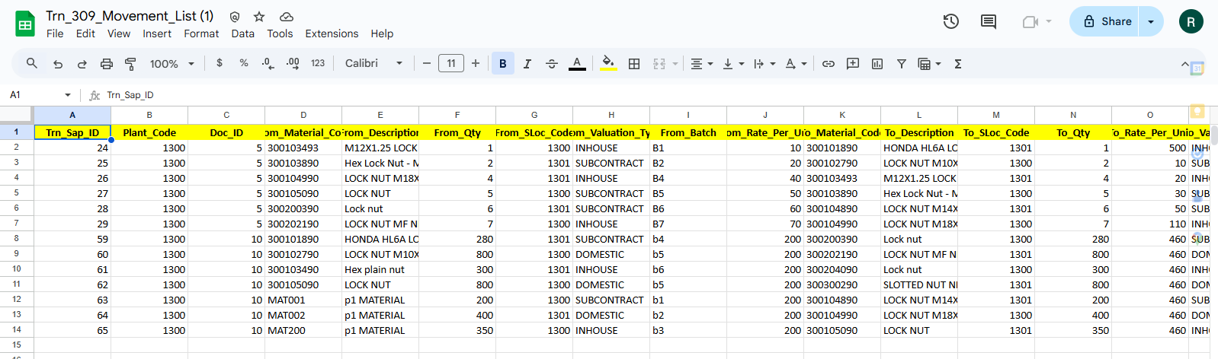
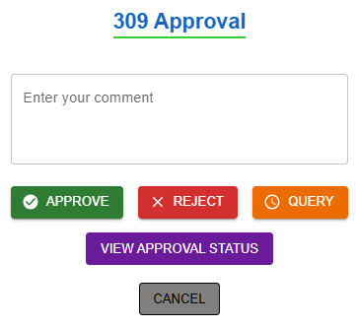
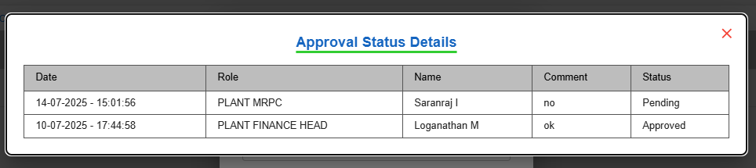
309 Movement Approval (Approver)
Pending request : View the Net Differences.
Then download the XLSX file to review the records.
After reviewing, take the appropriate Action: Approve, Reject, or Raise a Query.
(3) View Net Different
Approver Home Page
(2)View Net Difference, Download Records, Take Action
(1) Click here, 309 Approval
(6) Click Download Icon to View Records
(4)Action
(5) Click "View Approval Status" to See Last Update
Approver Make Action
Approval workflow: Request >>> L1 Approver: Plant Finance Head >>> L2 Approver: Plant MRPC >>> L3 Approver: Plant Head >>> L4 Approver: CORP Finance Head >>> L5 Approver: Corp MRPC

Slide 7
201 Movement Transaction
Process workflow:
1.Create Request by Users ( PROD / MMD / QAD / MED )
2.Upload Process - Fill in required details
3. Upload Output:
i) New Records, ii) Error Records, iii)Duplicate Records
4. Submit for Approval to Level 1 User.
Level 1 : PLANT FINANCE HEAD
Level 2 : PLANT MRPC
Level 3 : PLANT HEAD
Level 4 : CORP FINANCE HEAD
Level 5 : CORP MRPC
5. Requester Page Visible Data: - Only data uploaded by the logged-in user,
Statuses: Pending, Under Query
6. Download Option: - Filtered by From–To Date & Movement Type
7. Editability: - Enabled only if status is Under Query
8. Resubmit Workflow: - Enabled only if status is Under Query Select rows using checkboxes After making corrections, click Resubmit
5

Slide 8
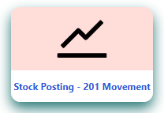
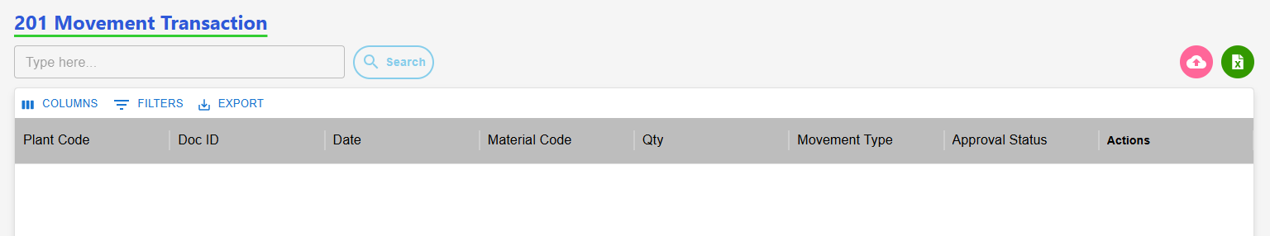
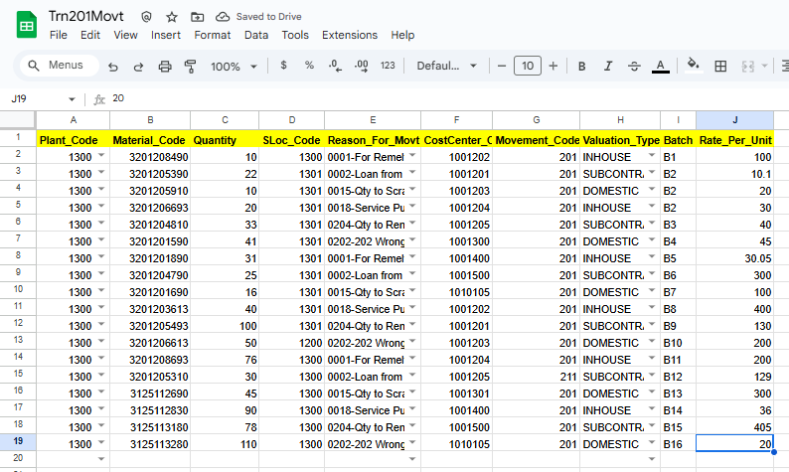
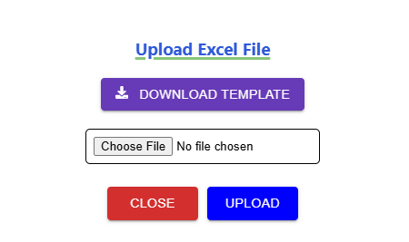
201 Movement Request (Requester)
(2)Click to Start a 201 Request
(2)Clic(2)Click to Start a 201 Request
k to Start a 201 Request
(1)Transaction Page Navigation
(2)Click to Start a 201 Request
201 Requester Page
(3) Click here to Download template
(5)Excel Template with Sample Data
(4) Click Row to Upload
(6) Approval workflow
Request >>> L1 Approver: Plant Finance Head >>> L2 Approver: Plant MRPC >>> L3 Approver: Plant Head >>> L4 Approver: CORP Finance Head >>> L5 Approver: Corp MRPC >>> Send to SAP.

Slide 9
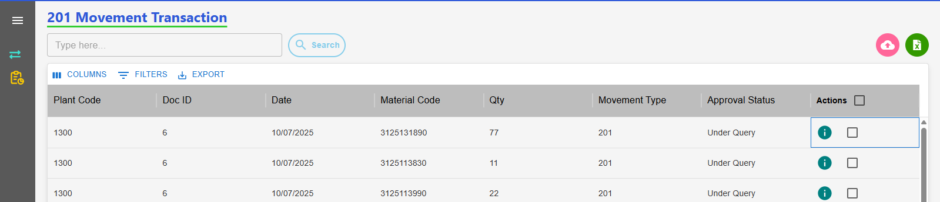
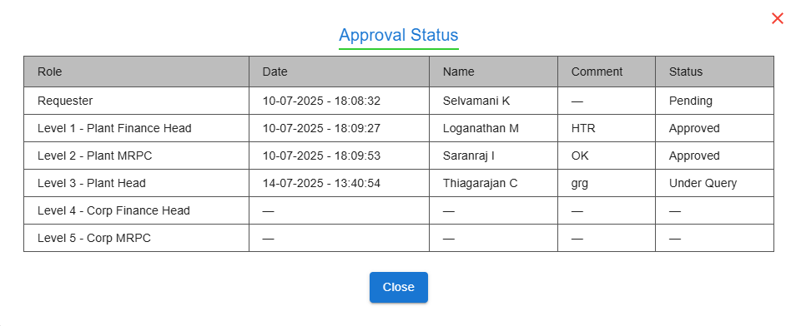
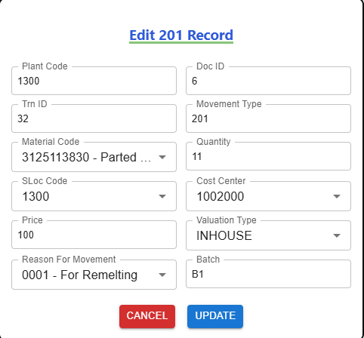
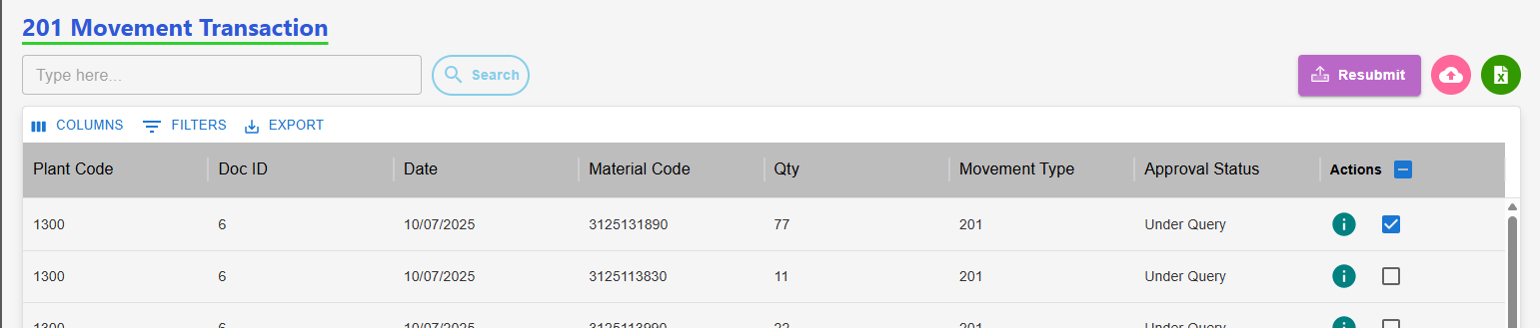
201 Movement: Edit with Status "Under Query" (Requester)
Requester Page After "Under Query" Status
(2) View the Approval Level & Status
(3) Click Row to Edit Row, Then Update
(1) Click here to View status
(4) Select Checkbox, Then Submit Data
Resubmit workflow
Status: Under Query>>> Edit>>> Re-submit>>>Send to Approver.

Slide 10
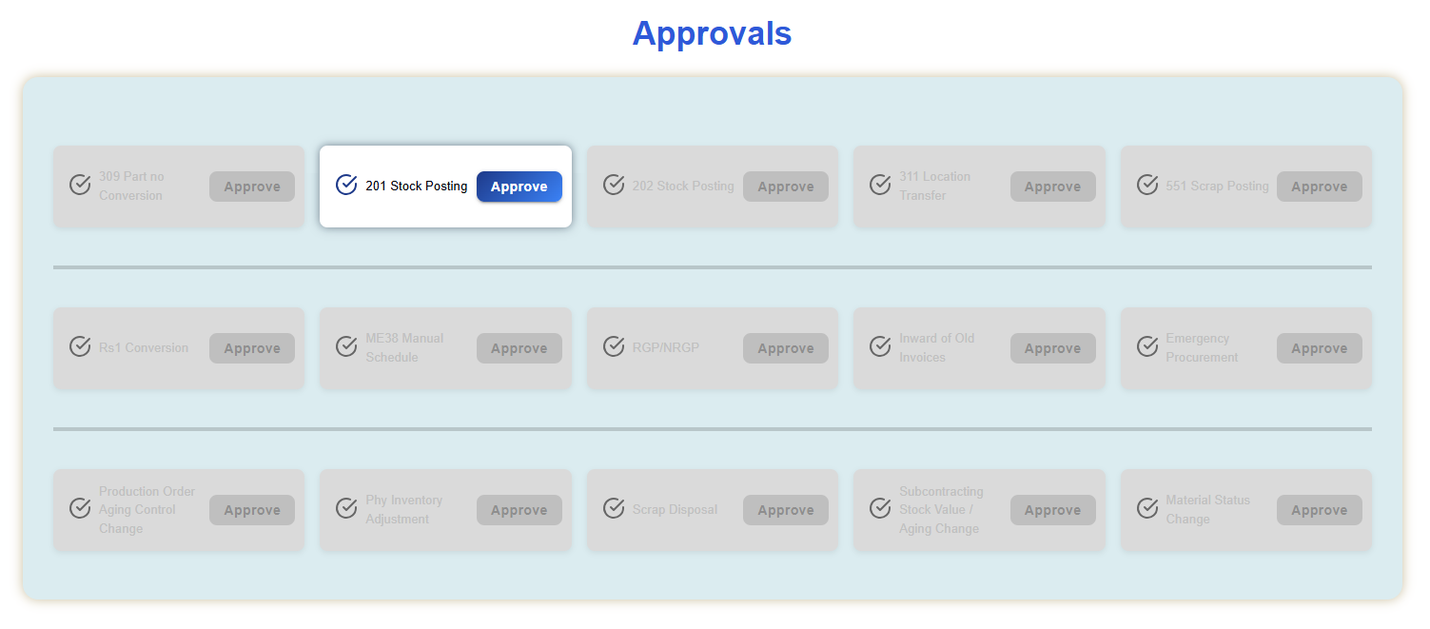
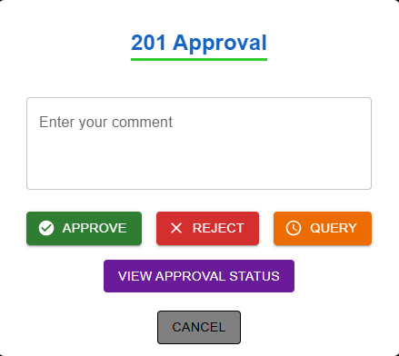
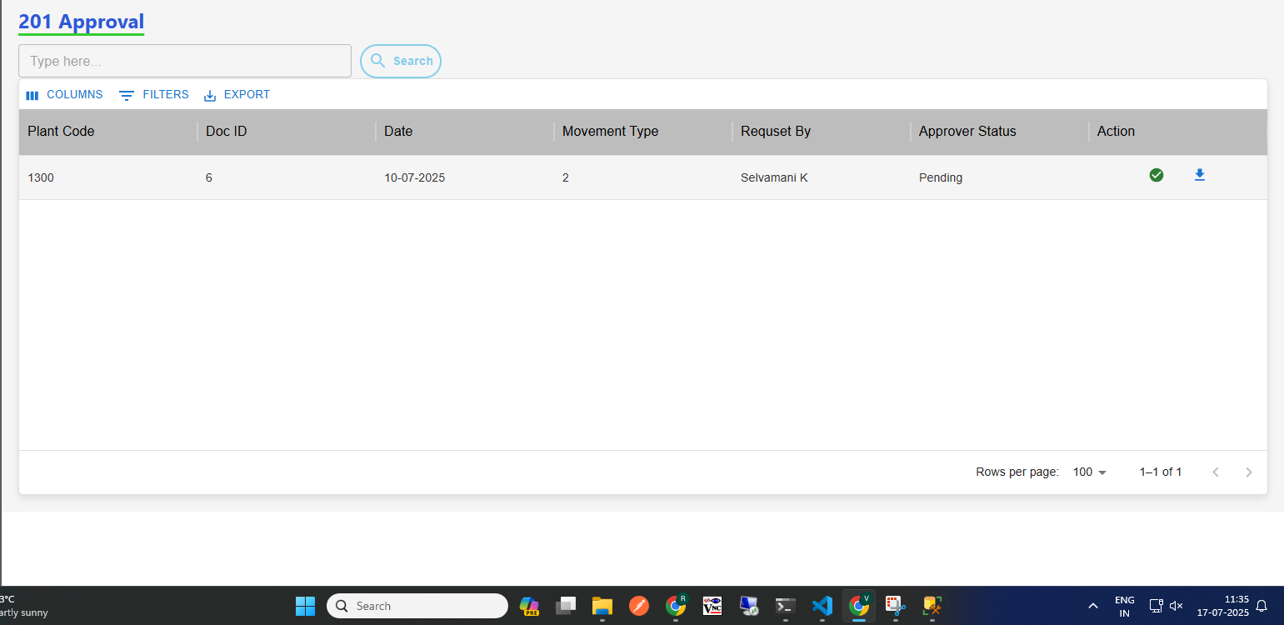
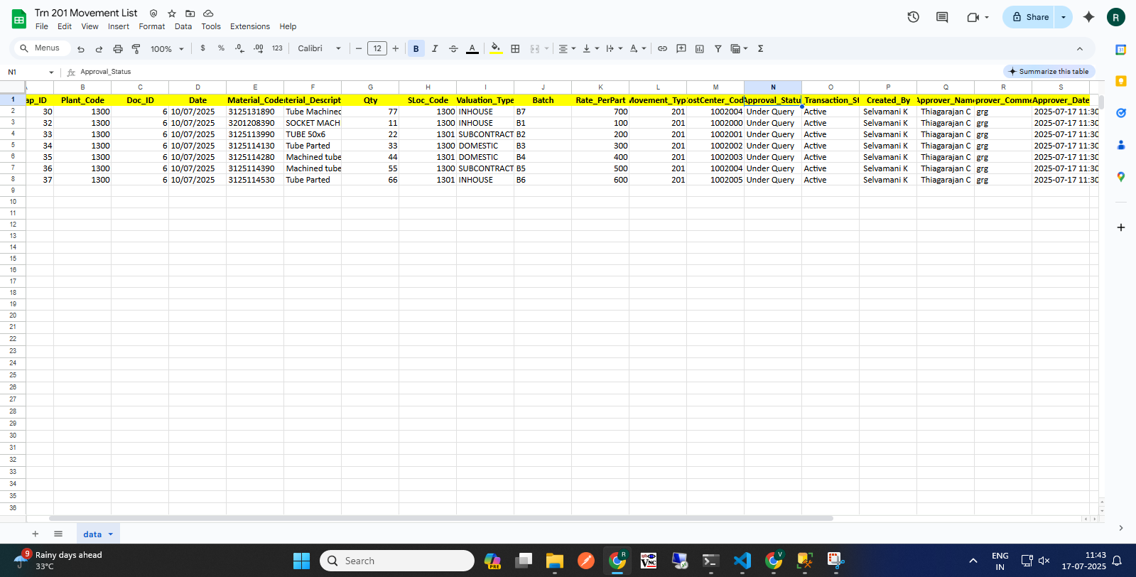
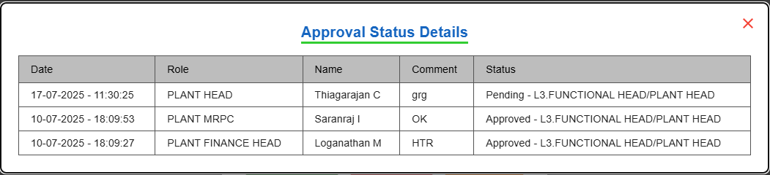
201 Movement Approval (Approver)
Pending request : View the Net Differences.
Then download the XLSX file to review the records.
After reviewing, take the appropriate Action: Approve, Reject, or Raise a Query.
View Status
(1)Approver Home Page
(2)Download Records, Take Action
(7)Action
(6) Click Download Icon to View Records
(5) Click "View Approval Status" to See Last Update
Approver Make Action
Approval workflow: Request >>> L1 Approver: Plant Finance Head >>> L2 Approver: Plant MRPC >>> L3 Approver: Plant Head >>> L4 Approver: CORP Finance Head >>> L5 Approver: Corp MRPC

Slide 11
202 Movement Transaction
Process workflow:
1.Create Request by Users ( PROD / MMD / QAD / MED )
2.Upload Process - Fill in required details
3. Upload Output:
i) New Records, ii) Error Records, iii)Duplicate Records
4. Submit for Approval to Level 1 User.
Level 1 : PLANT FINANCE HEAD
Level 2 : PLANT MRPC
Level 3 : PLANT HEAD
Level 4 : CORP FINANCE HEAD
Level 5 : CORP MRPC
5. Requester Page Visible Data: - Only data uploaded by the logged-in user,
Statuses: Pending, Under Query
6. Download Option: - Filtered by From–To Date & Movement Type
7. Editability: - Enabled only if status is Under Query
8. Resubmit Workflow: - Enabled only if status is Under Query Select rows using checkboxes After making corrections, click Resubmit
5

Slide 12
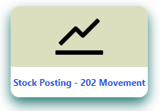
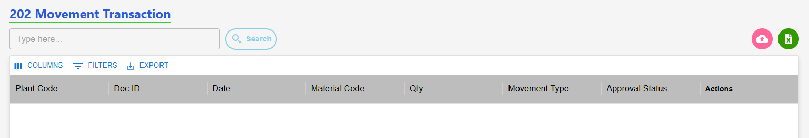
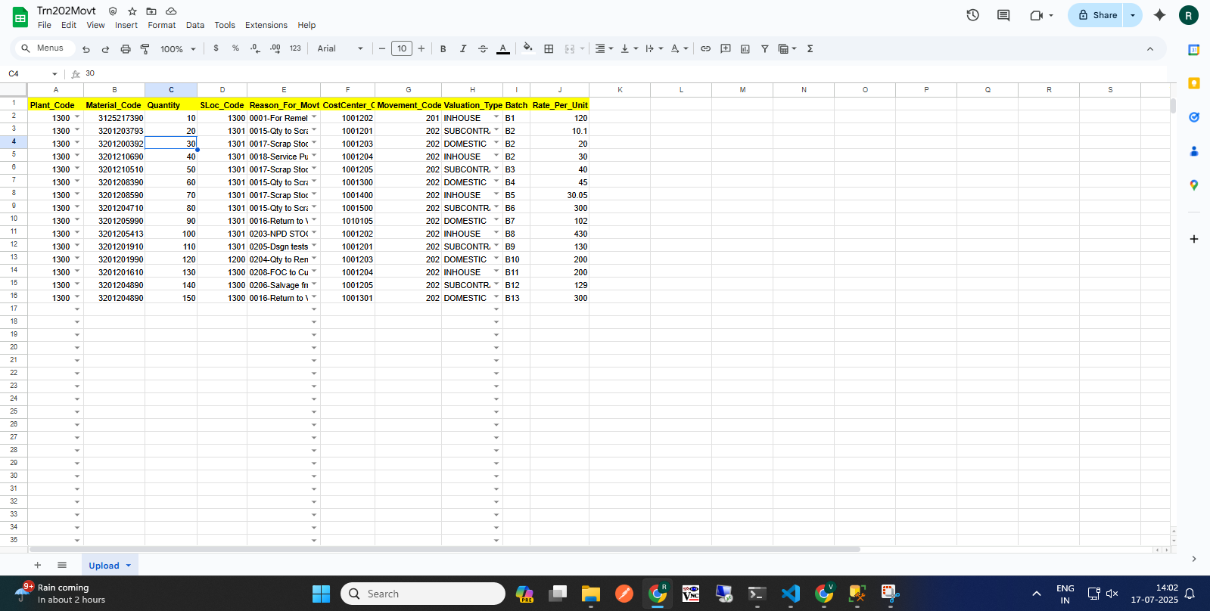
202 Movement Request (Requester)
(2)Click to Start a 201 Request
(2)Clic(2)Click to Start a 201 Request
k to Start a 201 Request
(1)Transaction Page Navigation
(2)Click to Start a 202 Request
202 Requester Page
(3) Click here to Download template
(5)Excel Template with Sample Data
(4) Click Row to Upload
(6) Approval workflow
Request >>> L1 Approver: Plant Finance Head >>> L2 Approver: Plant MRPC >>> L3 Approver: Plant Head >>> L4 Approver: CORP Finance Head >>> L5 Approver: Corp MRPC >>> Send to SAP.

Slide 13
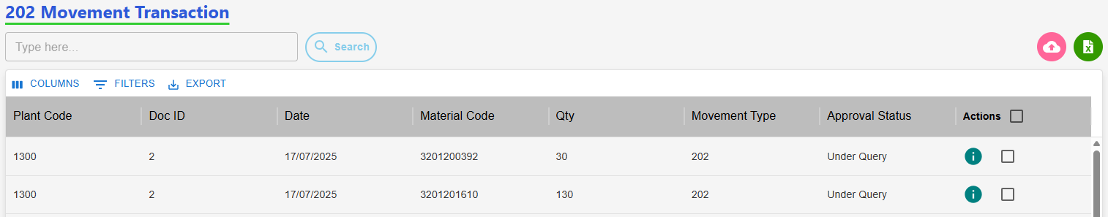
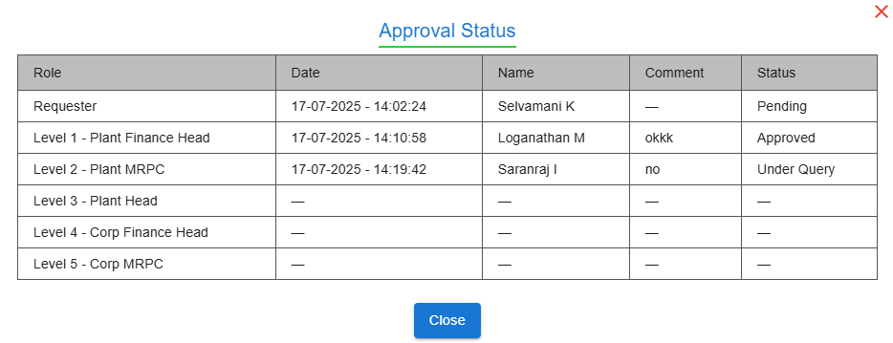
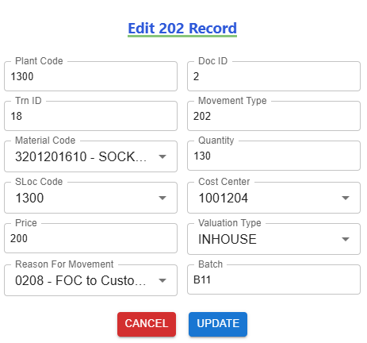
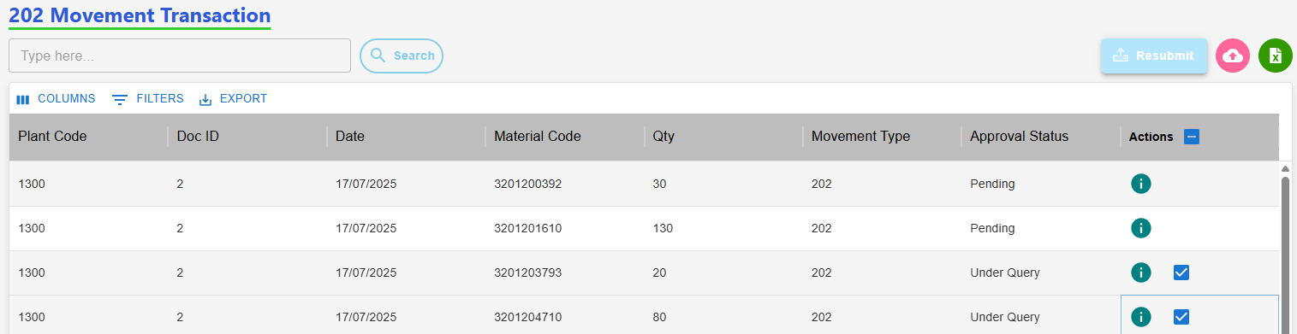
202 Movement: Edit with Status "Under Query" (Requester)
Requester Page After "Under Query" Status
(2) View the Approval Level & Status
(3) Click Row to Edit Row, Then Update
(1) Click here to View status
(4) Select Checkbox, Then Submit Data
Resubmit workflow
Status: Under Query>>> Edit>>> Re-submit>>>Send to Approver.

Slide 14
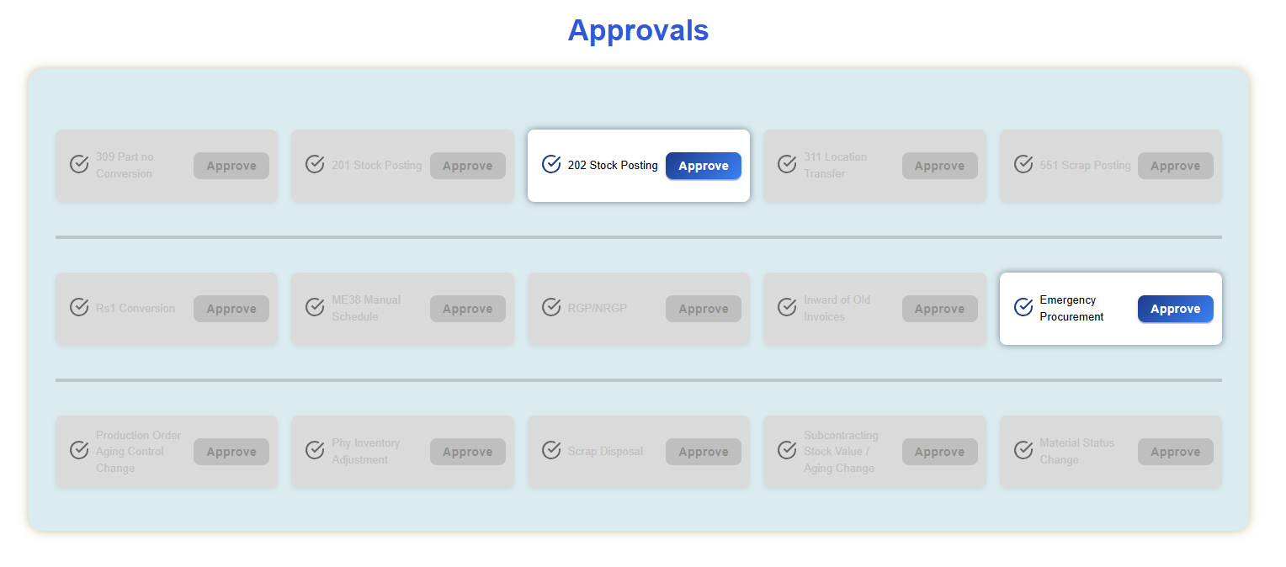
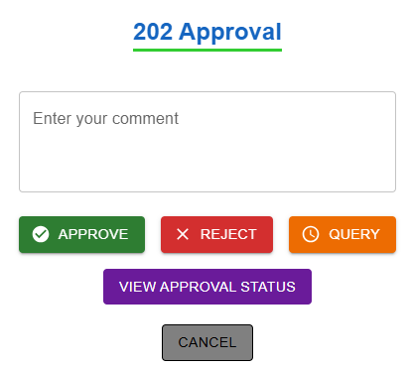
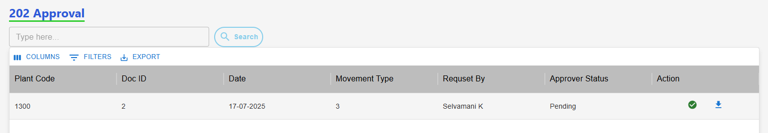
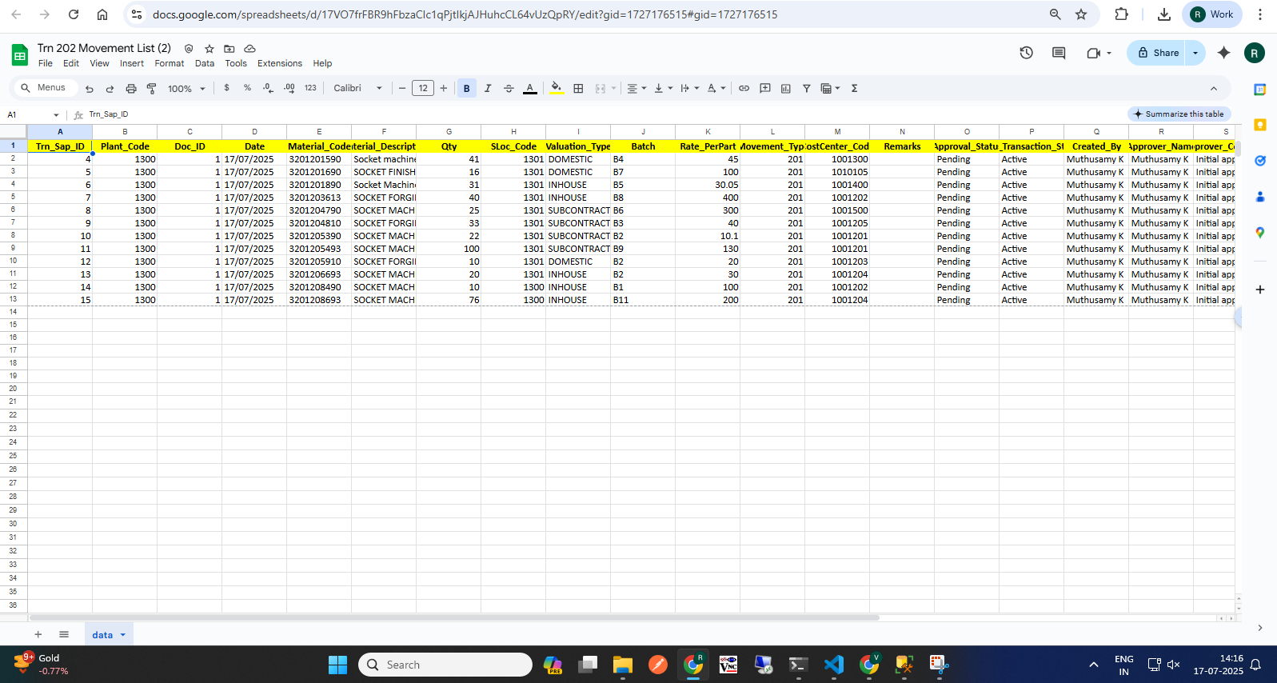
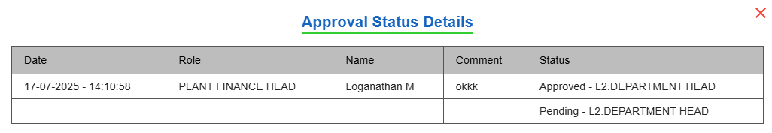
202 Movement Approval (Approver)
Pending request : View the Net Differences.
Then download the XLSX file to review the records.
After reviewing, take the appropriate Action: Approve, Reject, or Raise a Query.
View Status
(1)Approver Home Page
(2)Download Records, Take Action
(7)Action
(6) Click Download Icon to View Records
(5) Click "View Approval Status" to See Last Update
Approver Make Action
Approval workflow: Request >>> L1 Approver: Plant Finance Head >>> L2 Approver: Plant MRPC >>> L3 Approver: Plant Head >>> L4 Approver: CORP Finance Head >>> L5 Approver: Corp MRPC

Slide 15
551 Movement Transaction
Process workflow:
1.Create Request by Users ( PROD / MMD / QAD / MED )
2.Upload Process - Fill in required details
3. Upload Output:
i) New Records, ii) Error Records, iii)Duplicate Records
4. Submit for Approval to Level 1 User.
Level 1 : PLANT FINANCE HEAD
Level 2 : PLANT MRPC
Level 3 : PLANT HEAD
Level 4 : CORP FINANCE HEAD
Level 5 : BUSINESS HEAD
Level 6 : CORP MRPC
5. Requester Page Visible Data: - Only data uploaded by the logged-in user,
Statuses: Pending, Under Query
6. Download Option: - Filtered by From–To Date & Movement Type
7. Editability: - Enabled only if status is Under Query
8. Resubmit Workflow: - Enabled only if status is Under Query Select rows using checkboxes After making corrections, click Resubmit
5

Slide 16
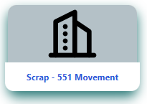
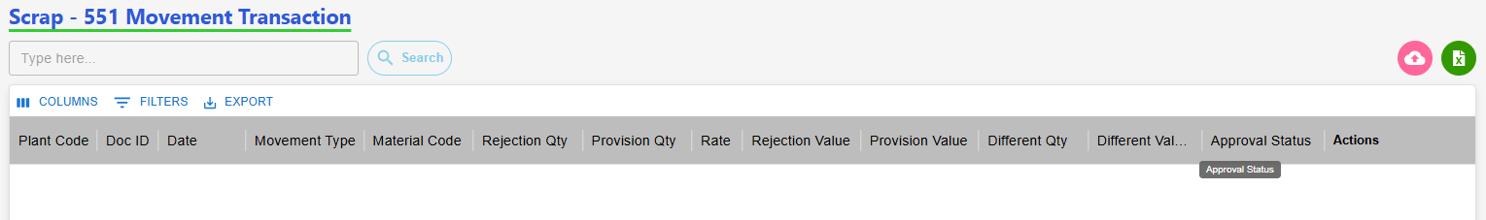
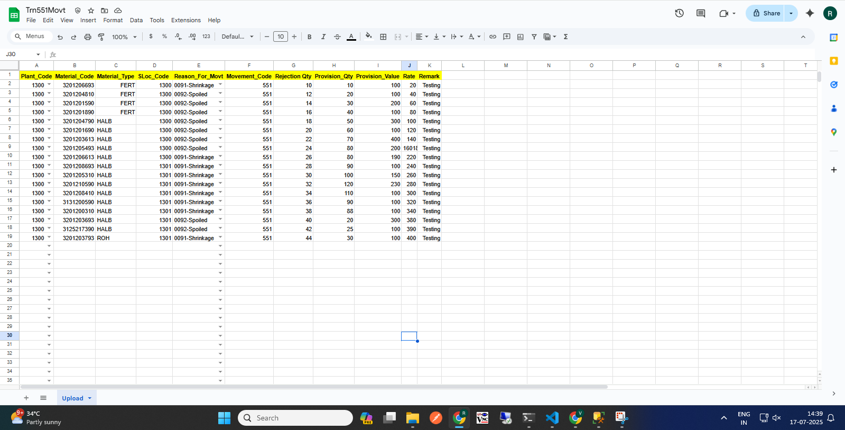
551 Movement Request (Requester)
(2)Click to Start a 201 Request
(2)Clic(2)Click to Start a 201 Request
k to Start a 201 Request
(3) Click here to Download template
(1)Transaction Page Navigation
(2)Click to Start a 551 Request
551 Requester Page
(5)Excel Template with Sample Data
(4) Click Row to Upload
(6) Approval workflow
Request >>> L1 Approver: Plant Finance Head >>> L2 Approver: Plant MRPC >>> L3 Approver: Plant Head >>> L4 Approver: CORP Finance Head >>> L5 Approver: Business Head>>> L6 Approver: Corp MRPC >>> Send to SAP.

Slide 17
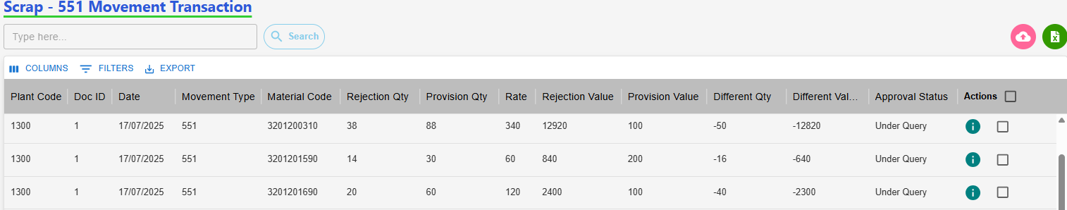
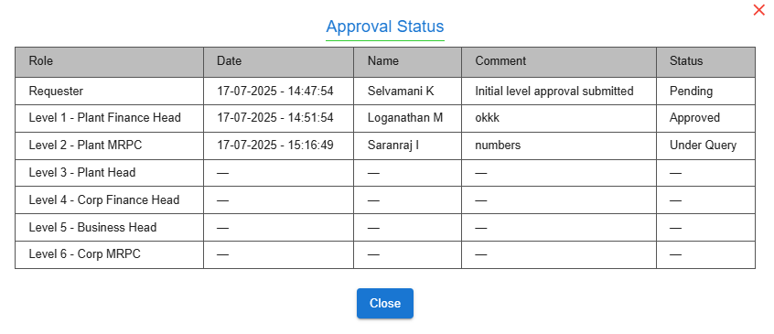
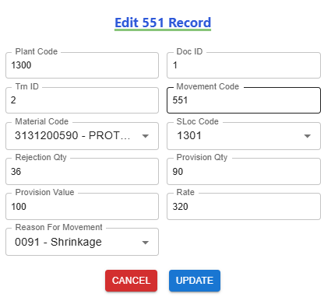
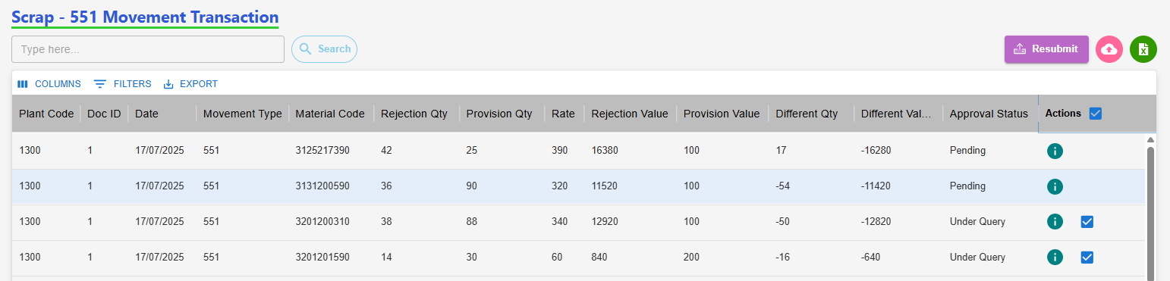
551 Movement: Edit with Status "Under Query" (Requester)
Requester Page After "Under Query" Status
(2) View the Approval Level & Status
(3) Click Row to Edit Row, Then Update
(1) Click here to View status
(4) Select Checkbox, Then Submit Data
Resubmit workflow
Status: Under Query>>> Edit>>> Re-submit>>>Send to Approver.

Slide 18
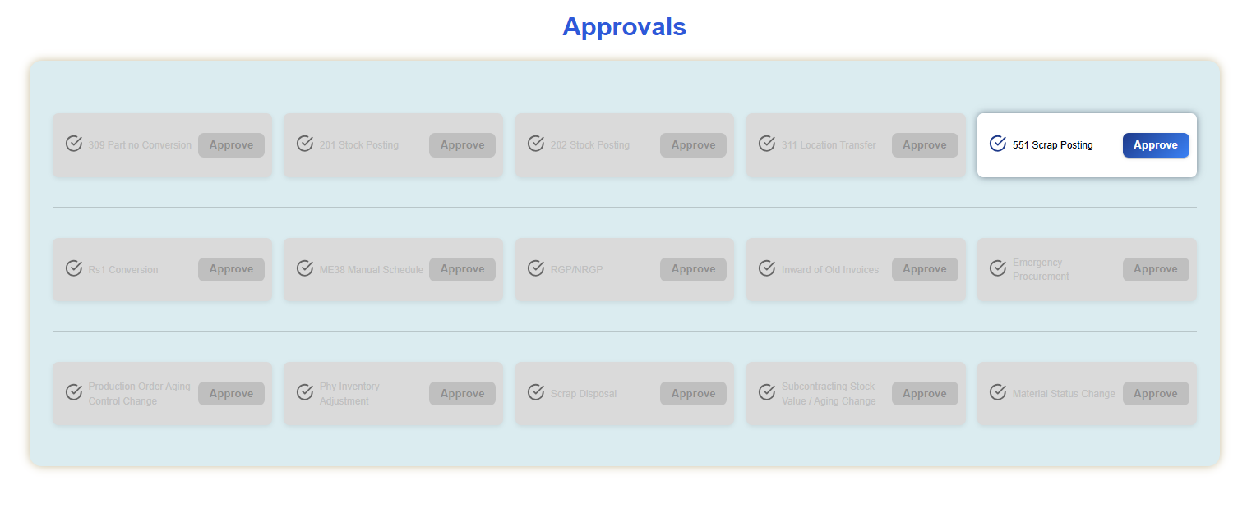
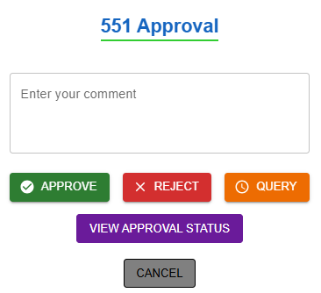


551 Movement Approval (Approver)
Pending request : View the Net Differences.
Then download the XLSX file to review the records.
After reviewing, take the appropriate Action: Approve, Reject, or Raise a Query.
View Status
(1)Approver Home Page
(2) Download Records, Take Action
(7)Action
(6) Click Download Icon to View Records
(5) Click "View Approval Status" to See Last Update
Approver Make Action
Approval workflow: Request >>> L1 Approver: Plant Finance Head >>> L2 Approver: Plant MRPC >>> L3 Approver: Plant Head >>> L4 Approver: CORP Finance Head >>> L5 Approver: Business Head>>> L6 Approver: Corp MRPC

Slide 19
311 Movement Transaction
Process workflow:
1.Create Request by Users ( PROD / MMD / QAD / MED )
2.Upload Process - Fill in required details
3. Upload Output:
i) New Records, ii) Error Records, iii)Duplicate Records
4. Submit for Approval to Level 1 User.
Level 1 : PLANT MRPC
5. Requester Page Visible Data: - Only data uploaded by the logged-in user,
Statuses: Pending, Under Query
6. Download Option: - Filtered by From–To Date & Movement Type
7. Editability: - Enabled only if status is Under Query
8. Resubmit Workflow: - Enabled only if status is Under Query Select rows using checkboxes After making corrections, click Resubmit
5

Slide 20



311 Movement Request (Requester)
(2)Click to Start a 201 Request
(2)Clic(2)Click to Start a 201 Request
k to Start a 201 Request
(1)Transaction Page Navigation
(2)Click to Start a 311 Request
311 Requester Page
(3) Click here to Download template
(5)Excel Template with Sample Data
(4) Click Row to Upload
(6) Approval workflow
Request >>> L1 Approver: Plant MRPC >>> Send to SAP.

Slide 21




311 Movement: Edit with Status "Under Query" (Requester)
Requester Page After "Under Query" Status
(2) View the Approval Level & Status
(3) Click Row to Edit Row, Then Update
(1) Click here to View status
(4) Select Checkbox, Then Submit Data
Resubmit workflow
Status: Under Query>>> Edit>>> Re-submit>>>Send to Approver.

Slide 22





311 Movement Approval (Approver)
Pending request : View the Net Differences.
Then download the XLSX file to review the records.
After reviewing, take the appropriate Action: Approve, Reject, or Raise a Query.
View Status
(1)Approver Home Page
(2) Download Records, Take Action
(7)Action
(6) Click Download Icon to View Records
(5) Click "View Approval Status" to See Last Update
Approver Make Action
Approval workflow: Request >>> L1 Approver: Plant MRPC

Slide 23
Conversion Rs.1 Movement Transaction
Process workflow:
1.Create Request by Users ( PROD / MMD / QAD / MED )
2.Upload Process - Fill in required details
3. Upload Output:
i) New Records, ii) Error Records, iii)Duplicate Records
4. Submit for Approval to Level 1 User.
Level 1 : PLANT FINANCE HEAD
Level 2 : PLANT HEAD
Level 3 : CORP FINANCE HEAD
Level 4 : BUSINESS HEAD
5. Requester Page Visible Data: - Only data uploaded by the logged-in user,
Statuses: Pending, Under Query
6. Download Option: - Filtered by From–To Date & Movement Type
7. Editability: - Enabled only if status is Under Query
8. Resubmit Workflow: - Enabled only if status is Under Query Select rows using checkboxes After making corrections, click Resubmit
5

Slide 24



Conversion Rs.1 Movement Request (Requester)
(2)Click to Start a 201 Request
(2)Clic(2)Click to Start a 201 Request
k to Start a 201 Request
(1)Transaction Page Navigation
(2)Click to Start a Rs.1 Request
Rs.1 Requester Page
(3) Click here to Download template
(5)Excel Template with Sample Data
(4) Click Row to Upload
(6) Approval workflow
Request >>> L1 Approver: Plant Finance Head >>> L2 Approver: Plant Head >>> L3 Approver: CORP Finance Head >>> L4 Approver: Business Head >>> Send to SAP.

Slide 25



Conversion Rs.1 Movt: Edit with Status "Under Query" (Requester)
Requester Page After "Under Query" Status
(2) View the Approval Level & Status
(3) Click Row to Edit Row, Then Update
(1) Click here to View status
(4) Select Checkbox, Then Submit Data
Resubmit workflow
Status: Under Query>>> Edit>>> Re-submit>>>Send to Approver.

Slide 26





Conversion Rs.1 Movement Approval (Approver)
Pending request : View the Net Differences.
Then download the XLSX file to review the records.
After reviewing, take the appropriate Action: Approve, Reject, or Raise a Query.
View Status
(1)Approver Home Page
(2) Download Records, Take Action
(7)Action
(6) Click Download Icon to View Records
(5) Click "View Approval Status" to See Last Update
Approver Make Action
Approval workflow: Request >>> L1 Approver: Plant Finance Head >>> L2 Approver: Plant Head >>> L3 Approver: CORP Finance Head >>> L4 Approver: Business Head

Slide 27
Inward of Old Invoices Movement Transaction
Process For Purchase workflow:
1.Create Request by Users ( PROD / MMD / QAD / MED )
2.Add Process - Fill in required details
3.Submit for Approval to Level 1 User.
Case (i)
Level 1 : CORP MRPC
Case (ii)
Level 1 : CORP MRPC
Level 2 : CORP FINANCE HEAD or CORP MMD HEAD
5. Requester Page Visible Data: - Only data uploaded by the logged-in user,
Statuses: Waiting, New, Rejected
6. Download Option: - Filtered by From–To Date
7. Editability: - Enabled only if status is Waiting, New, Rejected
Select rows using Edit After making corrections, Resubmit
5

Slide 28



Inward of Old Invoices Purchase Request (Requester)
(2)Click to Start a 201 Request
(2)Clic(2)Click to Start a 201 Request
k to Start a 201 Request
(1)Transaction Page Navigation
(2)Click to Start a Rs.1 Request
Rs.1 Requester Page
(3) Click here to Download template
(4) add
(6) Approval workflow
Request >>> L1 Approver: Plant Finance Head >>> L2 Approver: Plant Head >>> L3 Approver: CORP Finance Head >>> L4 Approver: Business Head >>> Send to SAP.

Slide 29





Inward of Old Invoices Purchase Resubmit (Requester)
(2)Click to Start a 201 Request
(2)Clic(2)Click to Start a 201 Request
k to Start a 201 Request
(1)Transaction Page Navigation
(2)Click to Start a Rs.1 Request
Rs.1 Requester Page
(6) Approval workflow
Request >>> L1 Approver: Plant Finance Head >>> L2 Approver: Plant Head >>> L3 Approver: CORP Finance Head >>> L4 Approver: Business Head >>> Send to SAP.

Slide 30






Inward of Old Invoices purchase Approval (Approver)
Action: View the purchase order details
Case 1: Corp MRPC Approval (Within 1-Year Period) If the PO falls within a 1-year period, the Corporate MRPC can approve it.
Case 2: Beyond 1 Year – Higher-Level Approval Required
If the PO exceeds the 1-year period, approval must come from either:Corporate MMD, or Corporate Finance Head
Last Level Approver ( Sap)- check box
(5) Click "View Approval Status" to See Last Update
(1)Approver Home Page
(2) Download Records, Take Action
Case 1
Case 2
View Status
Approver Make Action
Approval workflow: Request >>> L1 Approver: Plant Finance Head >>> L2 Approver: Plant Head >>> L3 Approver: CORP Finance Head >>> L4 Approver: Business Head

Slide 31
Inward of Old Invoices Movement Transaction
Process For Purchase workflow:
1.Create Request by Users ( PROD / MMD / QAD / MED )
2.Add Process - Fill in required details
3.Submit for Approval to Level 1 User.
Level 1 : PLANT FINANCE HEAD
Level 2 : CORP MRPC
Level 3 : CORP FINANCE HEAD
5. Requester Page Visible Data: - Only data uploaded by the logged-in user,
Statuses: Waiting, New, Rejected
6. Download Option: - Filtered by From–To Date
7. Editability: - Enabled only if status is Waiting, New, Rejected
Select rows using Edit After making corrections, Resubmit
5

Slide 32


Inward of Old Invoices Service Request (Requester)
(2)Click to Start a 201 Request
(2)Clic(2)Click to Start a 201 Request
k to Start a 201 Request
(1)Transaction Page Navigation
(2)Click to Start a Rs.1 Request
Rs.1 Requester Page
(3) Click here to Download template
(6) Approval workflow
Request >>> L1 Approver: Plant Finance Head >>> L2 Approver: Plant Head >>> L3 Approver: CORP Finance Head >>> L4 Approver: Business Head >>> Send to SAP.

Slide 33



Inward of Old Invoices Service Resubmit (Requester)
(2)Click to Start a 201 Request
(2)Clic(2)Click to Start a 201 Request
k to Start a 201 Request
(1)Transaction Page Navigation
(2)Click to Start a Rs.1 Request
Rs.1 Requester Page
(6) Approval workflow
Request >>> L1 Approver: Plant Finance Head >>> L2 Approver: Plant Head >>> L3 Approver: CORP Finance Head >>> L4 Approver: Business Head >>> Send to SAP.

Slide 34



Inward of Old Invoices Service Approval (Approver)
Action: View the Service order details
After View the order , then Take Action
Last Level Approver ( Sap)- check box
(5) Click "View Approval Status" to See Last Update
(1)Approver Home Page
(2) Download Records, Take Action
Approver Make Action
Approval workflow: Request >>> L1 Approver: Plant Finance Head >>> L2 Approver: Plant Head >>> L3 Approver: CORP Finance Head >>> L4 Approver: Business Head

Slide 35
Emergency Procurement Movement Transaction
Process For Purchase workflow:
1.Create Request by Users ( PROD / MMD / QAD / MED )
2.Add Process - Fill in required details
3.Submit for Approval to Level 1 User.
Level 1 : PLANT MRPC
Level 2 : PLANT FINANCE HEAD
Level 2 : PLANT HEAD
5. Requester Page Visible Data: - Only data uploaded by the logged-in user,
Statuses: Waiting, New, Rejected
6. Download Option: - Filtered by From–To Date
7. Editability: - Enabled only if status is Waiting, New, Rejected
Select rows using Edit After making corrections, Resubmit
Purchase Order Insert Later (If Not Update PO Mail Triger TO Approval’s)
5

Slide 36



Emergency Procurement Request (Requester)
(2)Click to Start a 201 Request
(2)Clic(2)Click to Start a 201 Request
k to Start a 201 Request
(1)Transaction Page Navigation
(2)Click to Start a Rs.1 Request
Rs.1 Requester Page
(3) Click here to Download template
(4) add
(6) Approval workflow
Request >>> L1 Approver: Plant Finance Head >>> L2 Approver: Plant Head >>> L3 Approver: CORP Finance Head >>> L4 Approver: Business Head >>> Send to SAP.

Slide 37



Emergency Procurement Resubmit (Requester)
(2)Click to Start a 201 Request
(2)Clic(2)Click to Start a 201 Request
k to Start a 201 Request
(1)Transaction Page Navigation
(2)Click to Start a Rs.1 Request
Rs.1 Requester Page
(6) Approval workflow
Request >>> L1 Approver: Plant Finance Head >>> L2 Approver: Plant Head >>> L3 Approver: CORP Finance Head >>> L4 Approver: Business Head >>> Send to SAP.

Slide 38


Emergency Procurement Approval (Approver)
Action: View the Service order details
After View the order , then Take Action
Last Level Approver ( Sap)- check box
(1)Approver Home Page
(2) Download Records, Take Action
Approver Make Action
Approval workflow: Request >>> L1 Approver: Plant Finance Head >>> L2 Approver: Plant Head >>> L3 Approver: CORP Finance Head >>> L4 Approver: Business Head

Slide 41
Thank you

